Slide 1
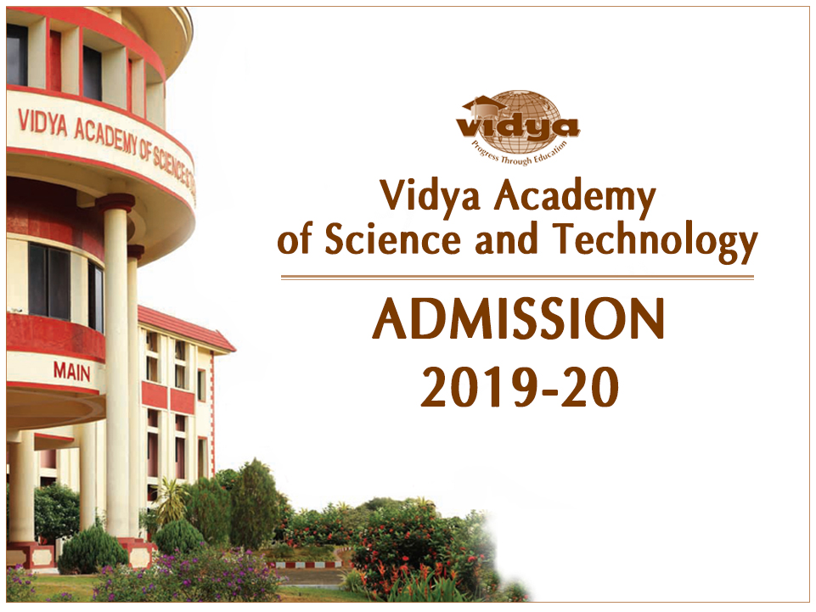

Slide 2
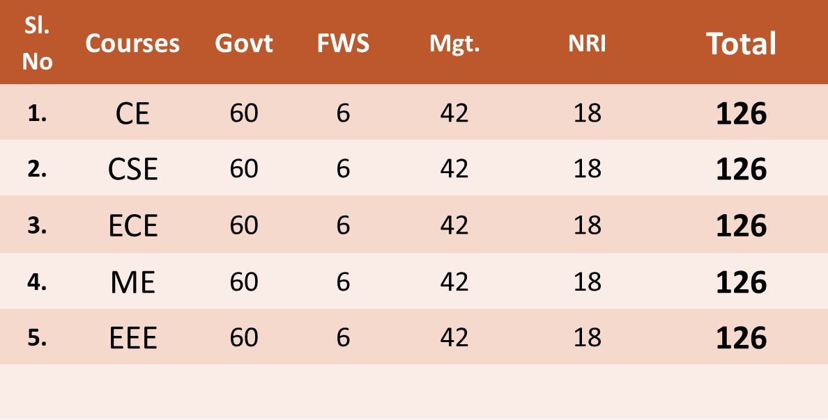
COURSES & SEATS – UG COURSES

Slide 3

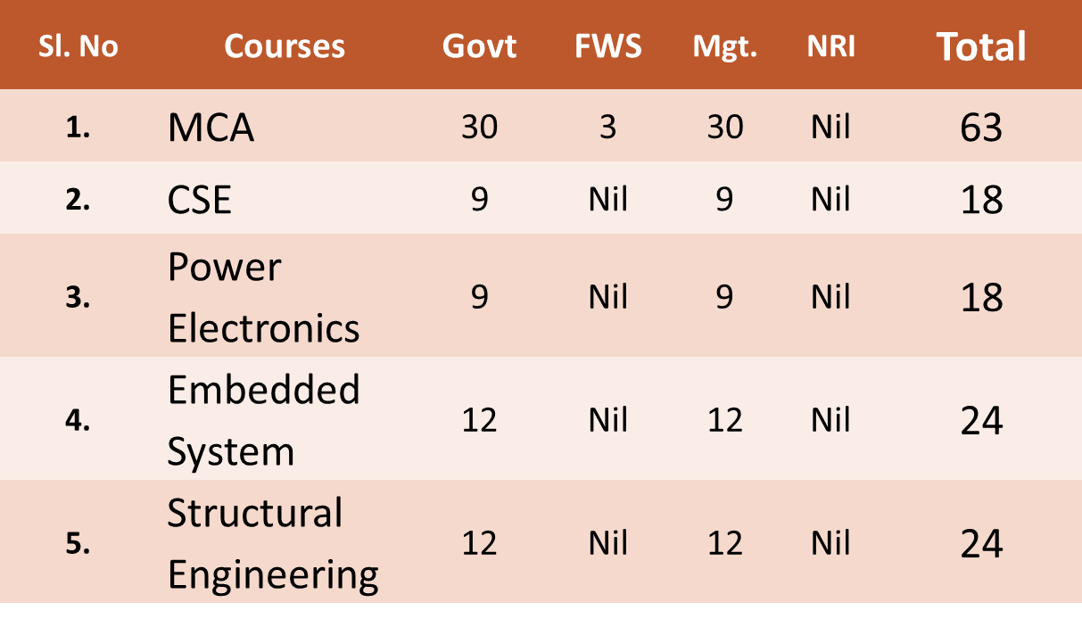

Slide 4
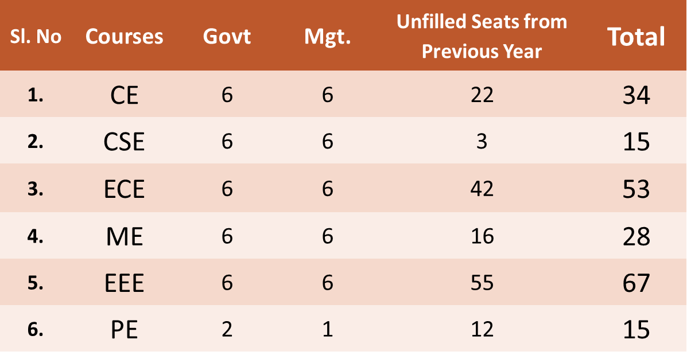
B.TECH - LE (Available Seats)

Slide 5
MCA - LE (Available Seats)
Govt – 3 seat
Mgt – 3 seat + unfilled seats

Slide 6
ACADEMIC ELIGIBLITY – B.TECH
B.TECH (Govt. Quota)
Passed Plus 2 with:
50% marks in Physics, Chemistry and Maths put together
50% marks in Maths separately
Qualified in the KEAM - 2019.
Name of the candidate included in the rank list.
Plus 2 marks uploaded to KEAM web portal
An equivalency certificate in case the candidate completed the Plus 2 course from other State Boards.

Slide 7
B.TECH -RELAXATION OF MARKS (Govt. Quota Admission)
Following category of candidates are eligible for a relaxation of 5% of marks, provided their total annual income does not exceed Rs. 8 Lakhs
SEBC
Persons with Disabilities (PD)
The SC/ST candidates need only pass marks in the qualifying examination

Slide 8
ACADEMIC ELIGIBLITY – B.TECH
B.TECH (Mgt. Quota)
Passed Plus 2 with:
45% marks in Physics, Chemistry and Maths put together
Qualified in the KEAM - 2019
An equivalency certificate in case the candidate completed the Plus 2 course from other State Boards.

Slide 9
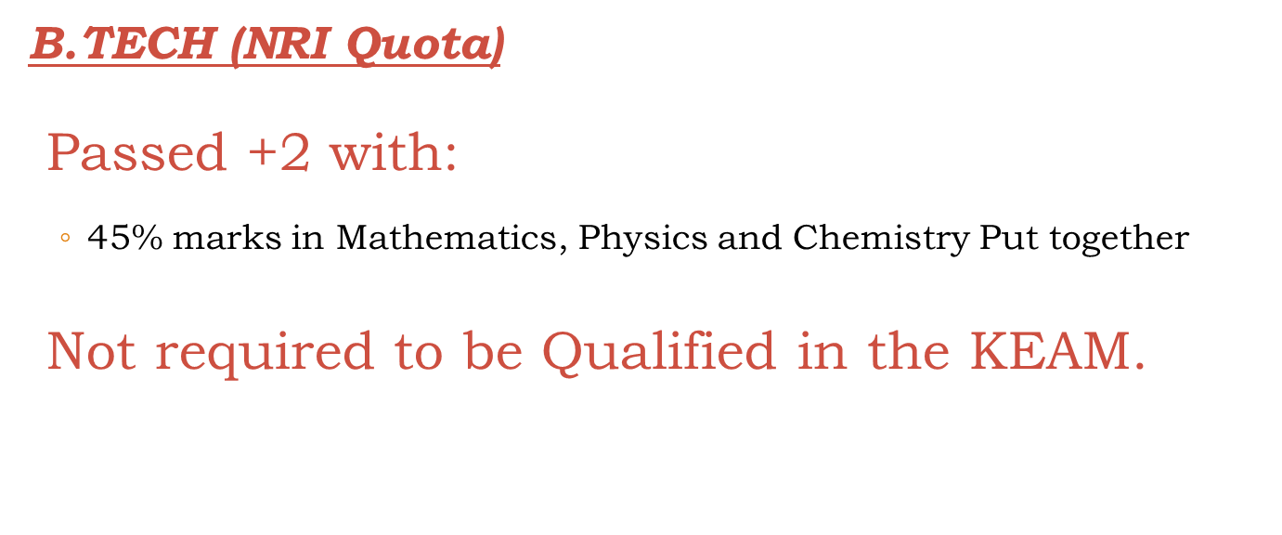
ACADEMIC ELIGIBLITY – B.TECH

Slide 10
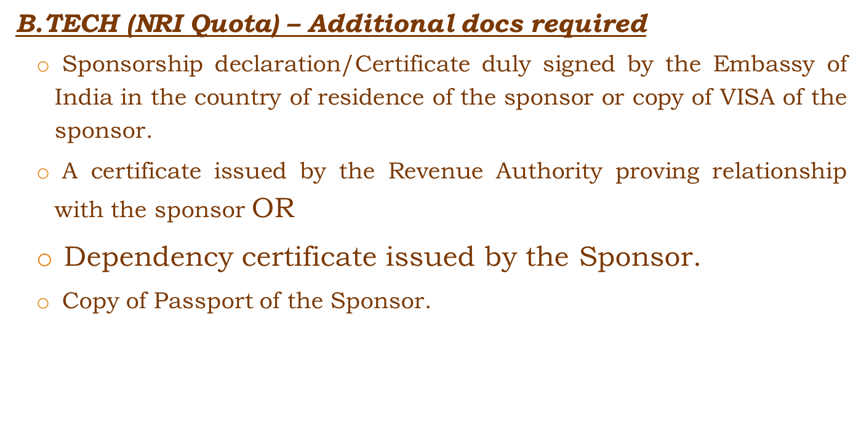
ACADEMIC ELIGIBLITY – B.TECH

Slide 11
ACADEMIC ELIGIBLITY B.TECH - LE (Govt. & Mgt.)
Diploma in Engineering (3 year course) awarded by the State Board of Technical Education or Equivalent.
Rank in Entrance Exam for Lateral Entry Test (LET).
Maximum age 30years.
An equivalency certificate in case the candidate completed the Diploma course outside of Kerala State

Slide 12
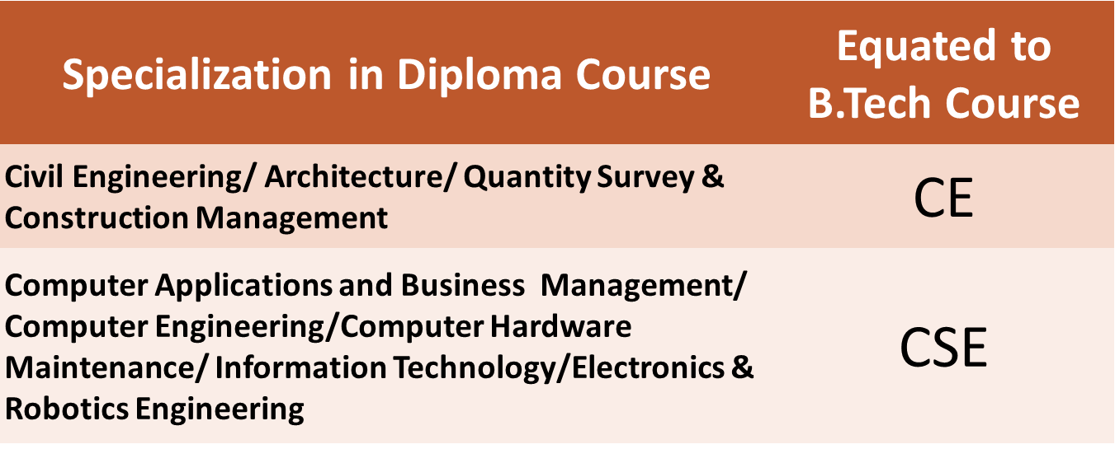
B.TECH LE (EQUIVALENCY OF BRANCHES)

Slide 13
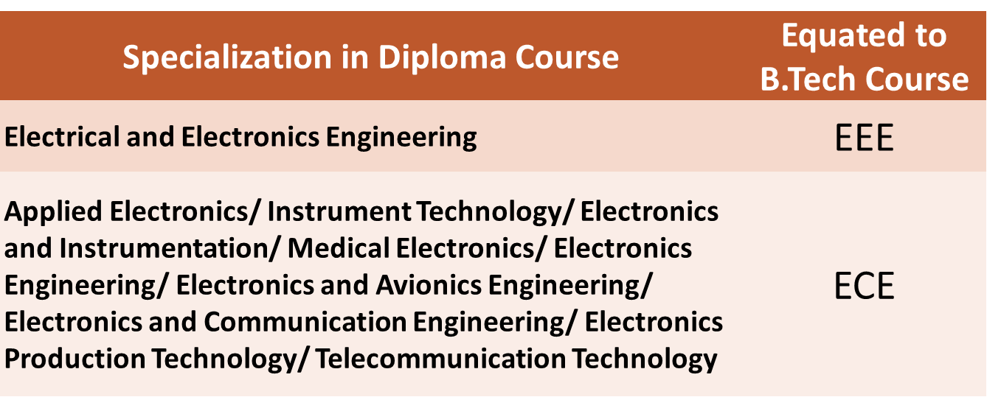
B.TECH LE (EQUIVALENCY OF BRANCHES)

Slide 14
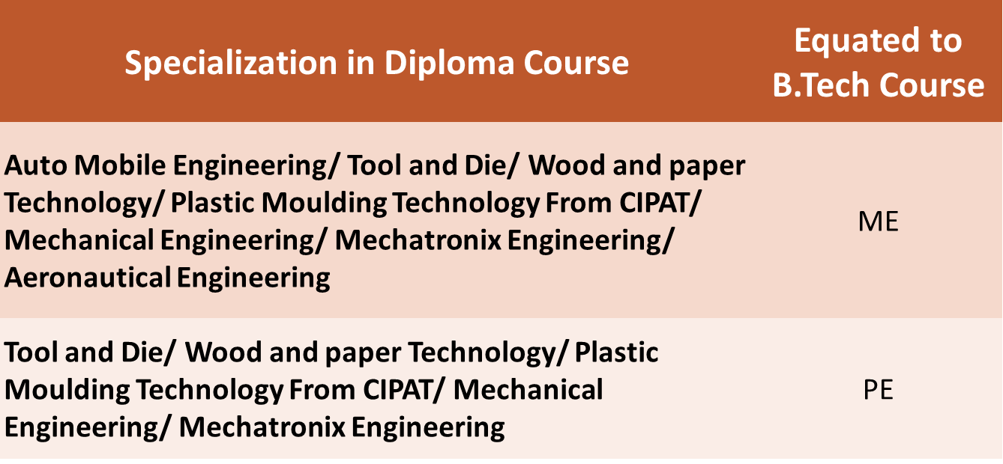
B.TECH LE (EQUIVALENCY OF BRANCHES)

Slide 15
ACADEMIC ELIGIBLITY – MCA (Govt. & Mgt.)
Any Bachelor’s Degree of minimum 3 years’ duration in any discipline:
with Maths at 10 + 2 level OR
Maths/Statistics as one of the subjects OR
BCA Degree
A minimum aggregate of 50% marks in Degree examination
Candidates should have qualified in the MCA ENTRANCE EXAM.
Equivalency certificate in case the candidate completed the Degree course from a University outside of Kerala State

Slide 16
ACADEMIC ELIGIBLITY – MCA LE (Govt. & Mgt.)
Bachelors degree in Computer Application/Computer Science of minimum 3 years’ duration in any discipline:
A minimum aggregate of 50% marks in Degree examination
Candidates should have qualified in the MCA Lateral Entry ENTRANCE EXAM.
Equivalency certificate in case the candidate completed the Degree course from a University outside of Kerala State

Slide 17
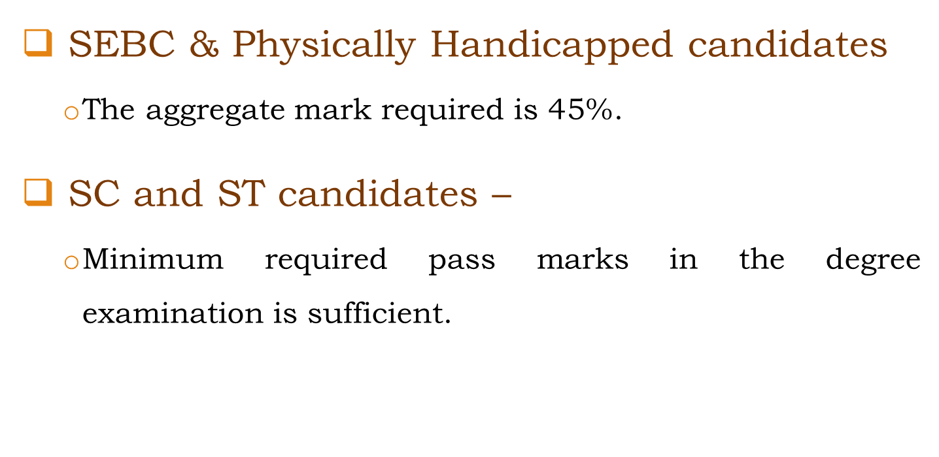
MCA (RELAXATION OF MARKS)

Slide 18
MCA LE (RELAXATION OF MARKS)
SEBC & Physically Handicapped candidates
The aggregate mark required is 45%.
SC and ST candidates –
Minimum required pass marks in the degree examination is sufficient.

Slide 19
ACADEMIC ELIGIBLITY – M.TECH (Govt. & Mgt.)
A minimum of 60% aggregate marks in the Engineering Degree examination.
AMIE/AMIETE degree holders shall satisfy the following conditions:
A valid GATE score.
A minimum of 55% marks for section B in AMIE/AMIETE.
An equivalency certificate in case the candidate completed the qualifying course from outside of Kerala State

Slide 20
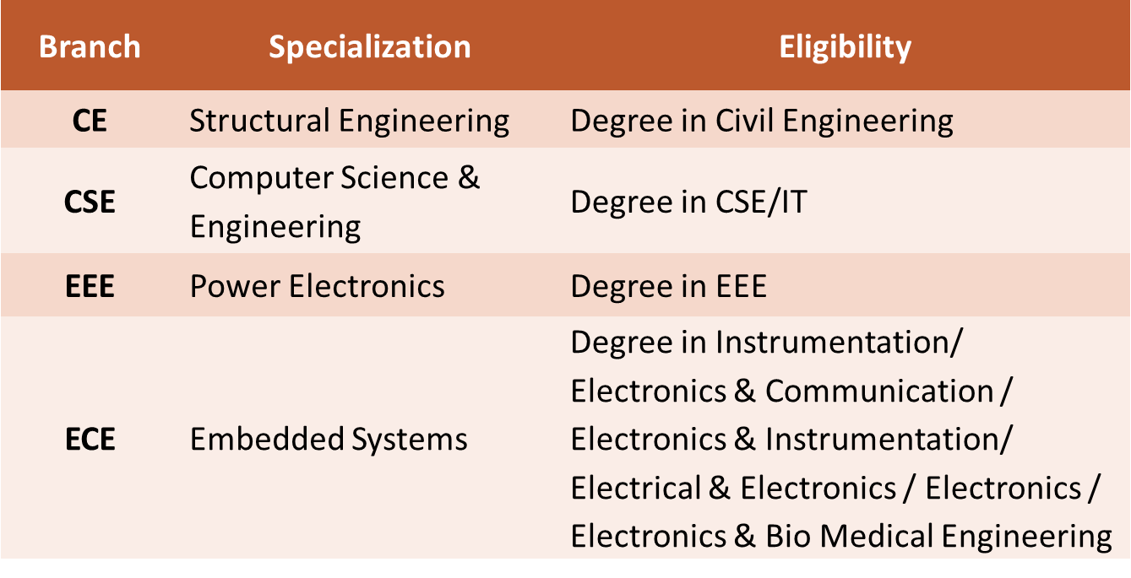
M.TECH (EQUIVALENCY OF BRANCHES)

Slide 21
M.TECH (RELAXATION OF MARKS)
SC/ST candidates:
Minimum pass marks in the Engineering Degree course is sufficient.
SEBC/OBC students:
A minimum of 54% aggregate marks in the Engineering Degree examination is sufficient.

Slide 22
MERITORIOUS SCHOLARSHIPS
Our College provides a number of meritorious scholarships based on percentage of marks in qualifying examination

Slide 23
VIDYA SCHOLARSHIPS
VIDYA MERIT-CUM- MEANS FULL FEE SCHOLARSHIPS
Eligibility Criteria
SEBC Category
Annual family income does not exceed Rs.100000/-
Admitted under Govt. Quota & Management Quota.
Courses & No of Scholarships
B-Tech:-30
LET Entry:-03
MCA:-03

Slide 24
VIDYA SCHOLARSHIPS
VIDYA MERIT-CUM- MEANS HALF FEE SCHOLARSHIPS
Eligibility Criteria
Annual family income does not exceed Rs.150000/-.
Admitted under Govt. Quota.
Courses & No of Scholarships
B-Tech:-20
LET Entry:-03
MCA:-03

Slide 25
TENTATIVE SCHEDULE
B.TECH
1 | Commencement of issue & online application for Mgt. seat admission | 05 Apr 2019
2 | Last date for receipt of filled application in the college/closing of online application | 31-May-19 *
3 | Declaration of Mgt. merit list | 5th day after closing date of online application
4 | Counseling for Mgt. seat admission | 7th day after publishing of vidya merit list Jun 2019
5 | Class starts | 01 Aug 2019

Slide 26
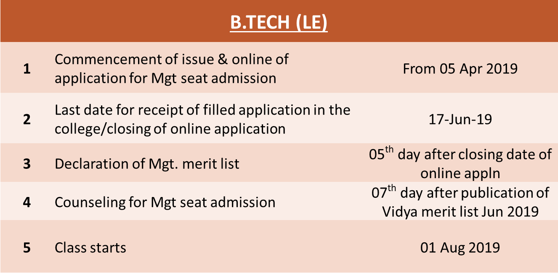
TENTATIVE SCHEDULE

Slide 27
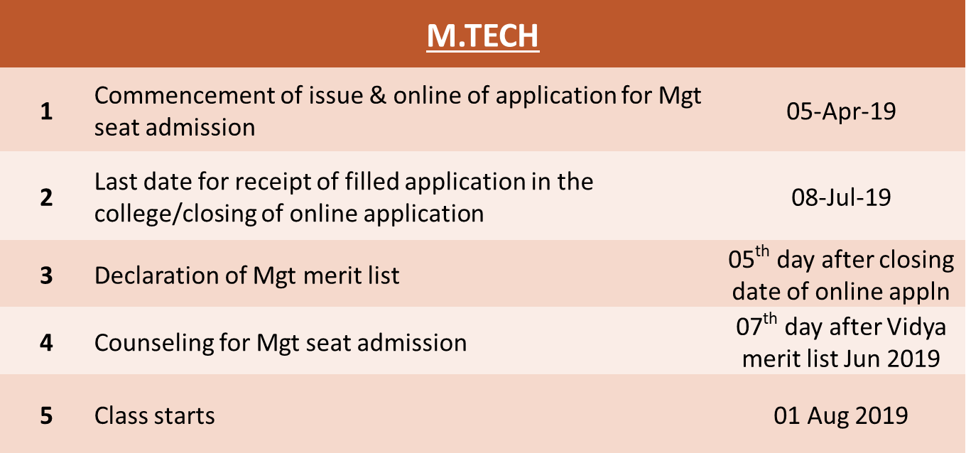
TENTATIVE SCHEDULE

Slide 28
TENTATIVE SCHEDULE
MCA
1 | Commencement of issue & online of application for Mgt. seat admission | 05 Apr 2019
2 | Last date for receipt of filled application in the college/closing of online application | 16-July-19
3 | Declaration of Mgt merit list | 05th day after closing date of online appln
4 | Counseling for Mgt seat admission | 07th day after publication of Vidya merit list Jun 2019
5 | Class starts | 01 Aug 2019

Slide 29
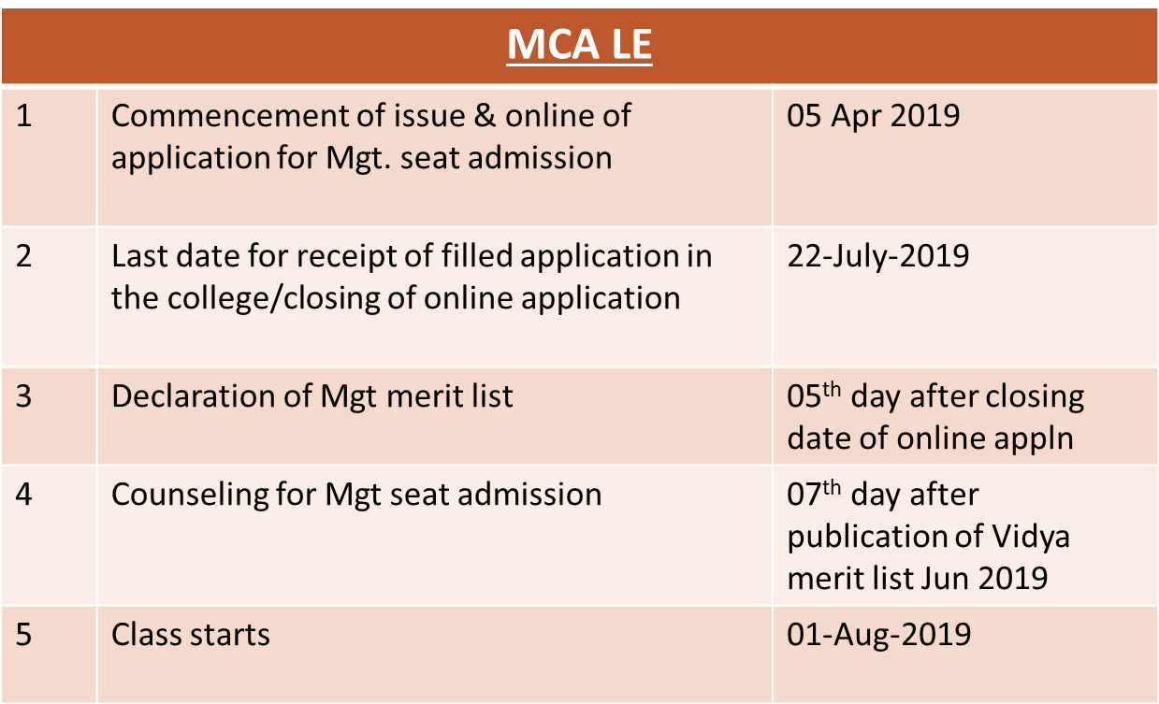
TENTATIVE SCHEDULE

